Slide 1






Image processing w/ Python: Welcome Candace Makeda Moore, Jaro Camphuijsen, Giulia Crocioni, Thijs Vroegh

Slide 2
Image processing w/ Python: We will teach you some basic skills that will let you deal with images through code. This is only a start! I encourage you to apply what you learn to your own work, and learn as you encounter real-world problems.

Slide 3
Schedule day one
9:00 | Welcome and Introduction + setup check
9:20 | Image Basics
9:40 | Working with the skimage library
10:30 | Coffee break
10:40 | Drawing +
11:40 | Bitwise Operations
12:30 | Wrap up
12:40 | Feedback collection
13:00 | END day 1

Slide 4
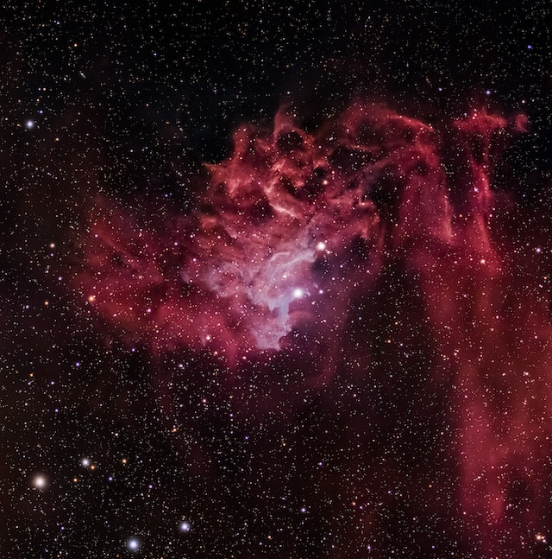

Set up check:
Repo cloned?
(https://github.com/esciencecenter-digital-skills/image-processing/)
Environment entered?
Can you start running the extra materials notebook?
Collaborative document open?
Photo by Scott Lord on Unsplash
Notes:
Switch here to the collaborative document

Slide 5
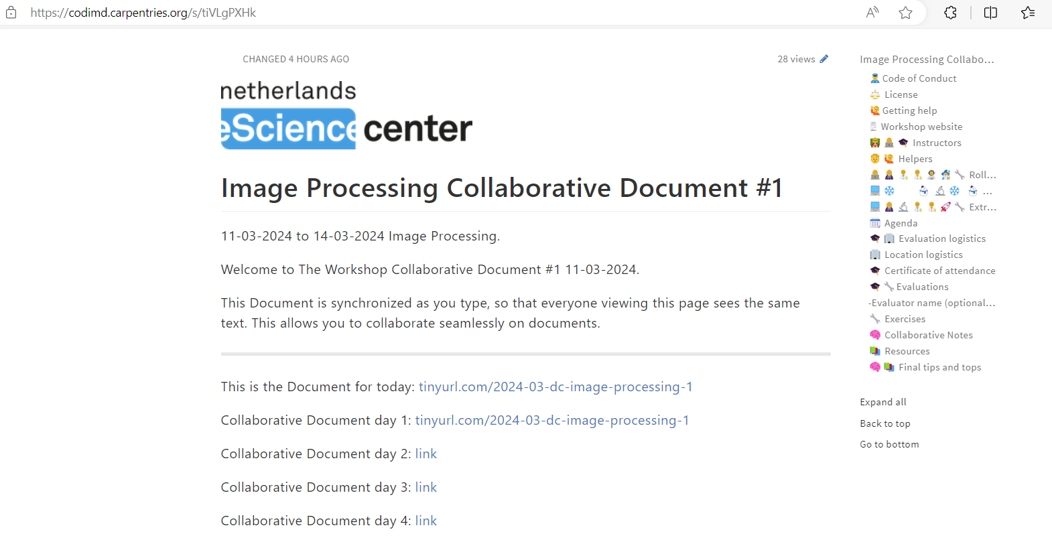
Go to the collaborative document please
Notes:
Switch here to the collaborative document

Slide 6

The Netherlands eScience Center

Slide 7

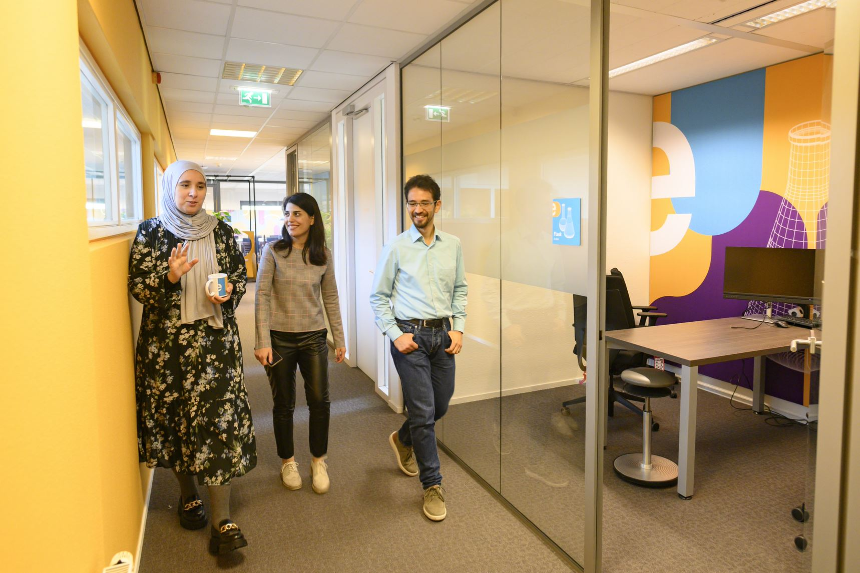
Who are we?
The Netherlands eScience Center is a national center for innovative software solutions in academic research.
Our Research Software Engineers
help researchers interpret results,
make tools and methods reusable for the wider research community,
co-author research and methodological publications.

Slide 8
Training Programme​​
1. For researchers & RSEs
Digital skills workshops, see schedule next slide
2. For data stewards, information specialists and DCCs
Research support masterclass
Online materials
3. For training the trainer
Carpentries instructor training
Carpentries collaborative lesson development
4. For organisations (externally organized workshops based on our digital skills workshops)
Format
Hands-on courses, 2-3 days
In person & online
Based on The Carpentries & CodeRefinery, and in-house developed materials.

Slide 9

Schedule 2024
January |  | July
February | Introduction to deep learning Good Practices in Research Software Development | August | Parallel Programming with Python
March | Image Processing with Python Parallel Programming with Python | September | Introduction to Deep Learning Image Processing with Python
April | Good Practices in Research Software Development Machine learning in python with scikit-learn Intermediate Research Software Development with Python | October | Collaborative version control with git and GitHub Machine learning in python with scikit-learn
May | Introduction to Geospatial Raster and Vector Data with Python Collaborative version control with git and GitHub | November | Carpentries instructor training Reproducible research with R packages
June | GPU programming Carpentries instructor training | December | GPU programming Intermediate Research Software Development with Python
For exact dates of upcoming workshops (3 months in advance): esciencecenter.nl/events/?f=workshops
To be notified about coming up workshops, subscribe to the Newsletter: eepurl.com/dtjzwP

Slide 10
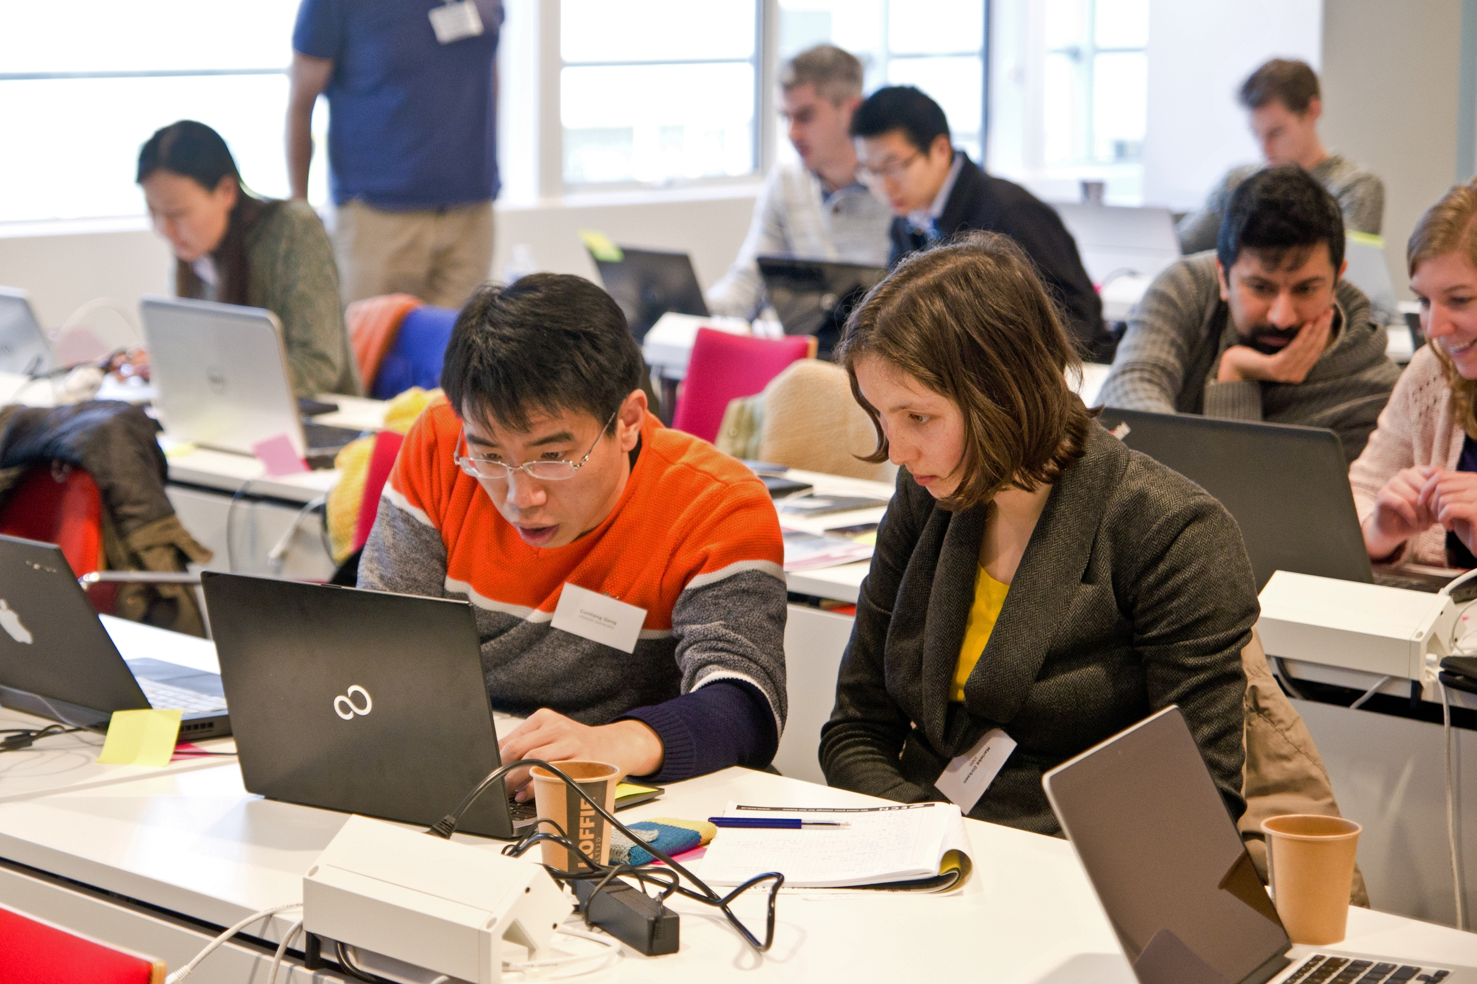


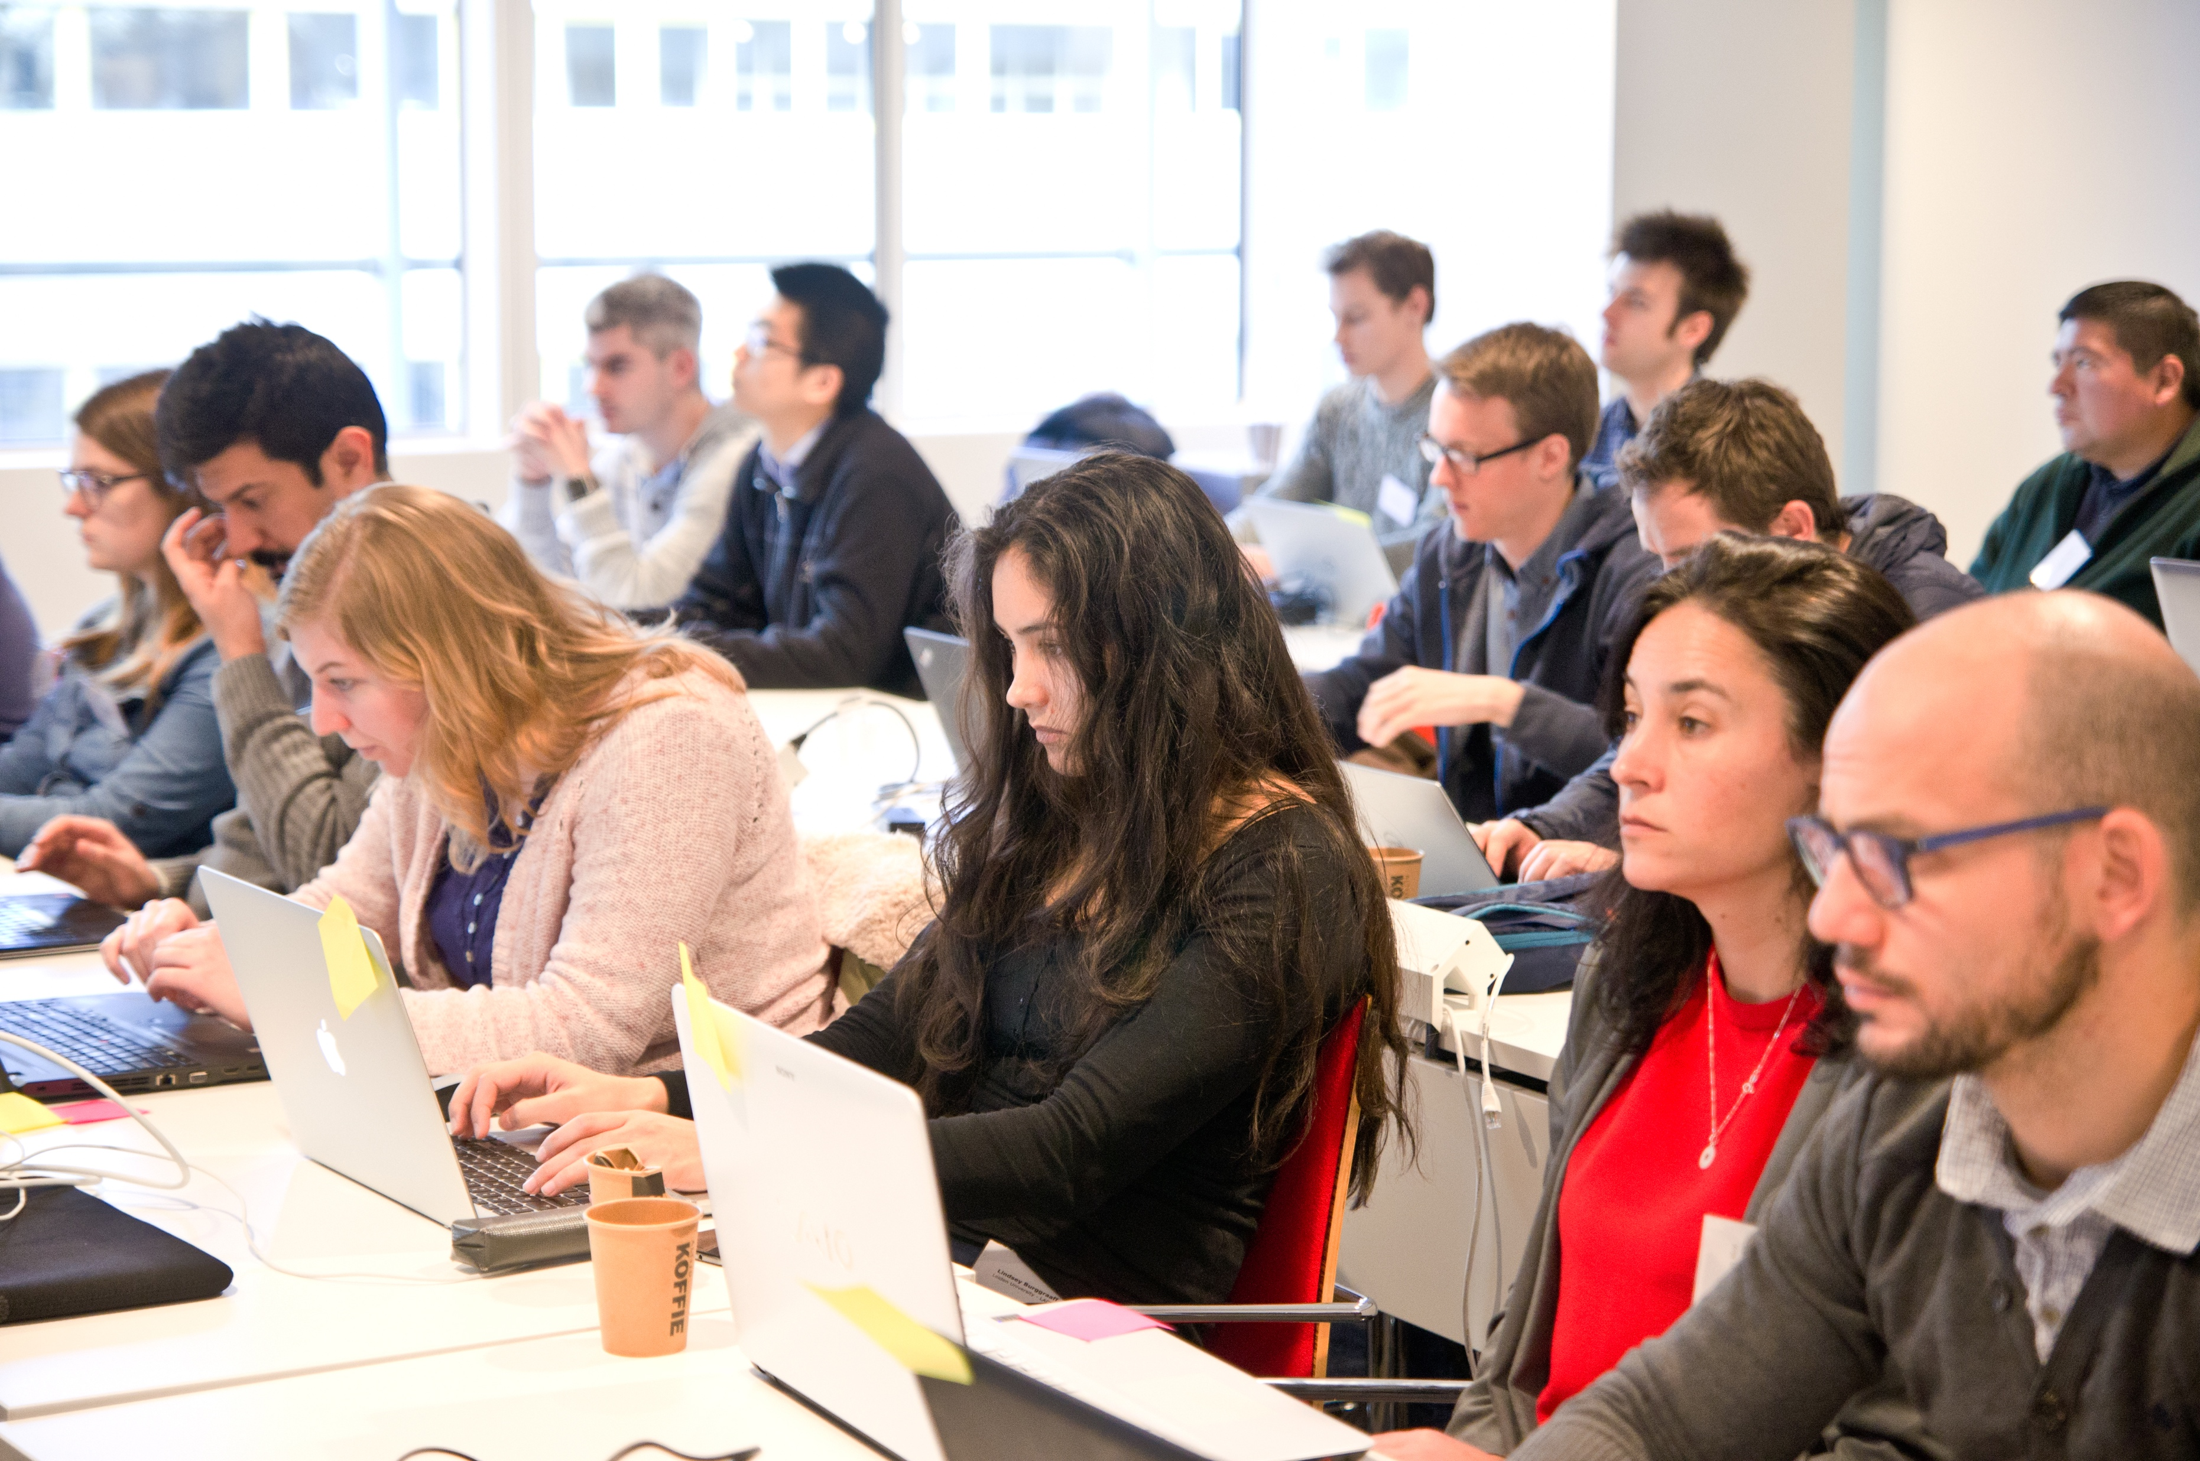

Our Digital Skills Workshops are open to researchers in the Netherlands. We also offer paid options of standard and custom workshops dedicated to your organisation. To learn more, contact: training@esciencecenter.nl
Do you want us to come and teach a workshop at your organisation?

Slide 11
Do you want to teach with our materials?
All material that we use is open-source and available online
We can help you setup workshops, contact training@esciencecenter.nl

Slide 12
Submit now!
Become part of the eScience Center community and meet with other Fellows: passionate advocates of research software (3 times a year)
Open to researchers and research software enthusiasts from all disciplines
Receive training, budget and consultancy from eScience Center employees on improving awareness and community efforts around research software
Timeline:
11 April: Deadline project proposal
Early May: Interviews
7 June: kick-off
Fellowship Programme 2023-2024
More info and apply at: esciencecenter.nl/fellowship-programme

Slide 13
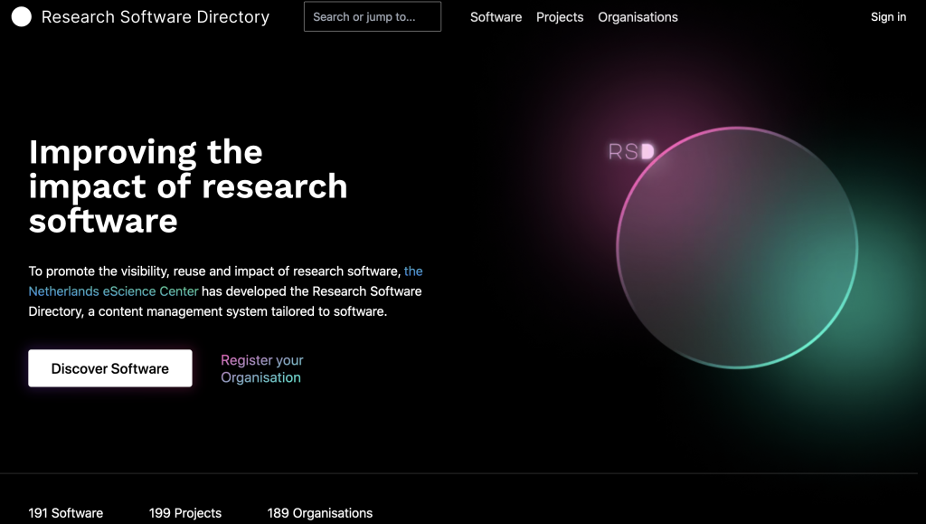

NleSC: a hub in the research community
The Research Software Directory:
Facilitates researchers to find and quickly judge the relevance and quality of research software
NL-RSE brings together people creating research software from Dutch universities, knowledge institutes, and other organizations to share knowledge, to organize meetings, and raise awareness for the scientific recognition of research software.
Website: research-software-directory.org
Website: https://nl-rse.org/
Email: info@nl-rse.org
Twitter: @nl_rse
And, of course, grants for research in many disciplines!

Slide 14
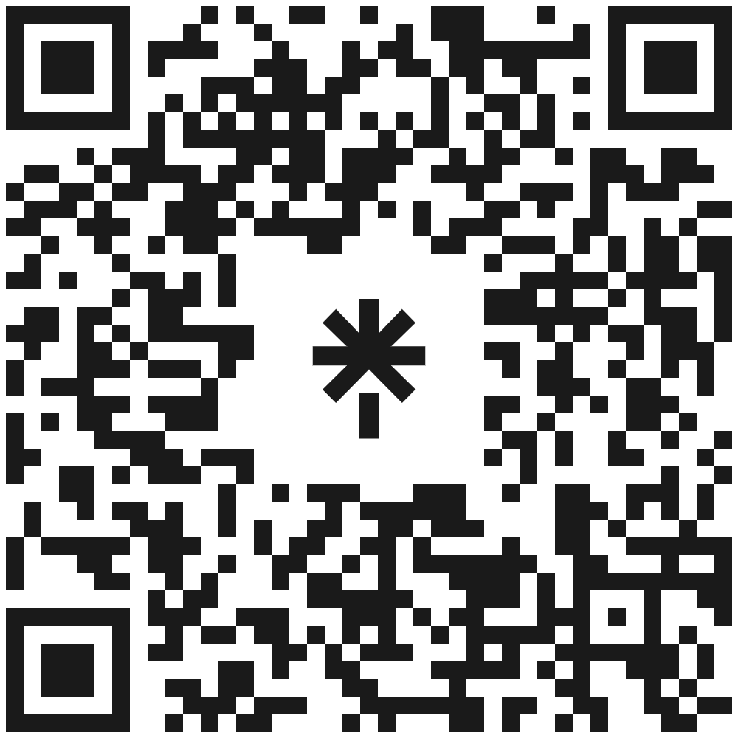







Let’s stay in touch
https://www.esciencecenter.nl/digital-skills/
training@esciencecenter.nl
+31 (0)20 460 4770
@eScienceCenter
Netherlands Escience Center
@eScienceCenter@akademienl.social

